Slide 1

LANL Earthquake Prediction
Can you predict upcoming laboratory earthquakes?
Presented by:
Blesson Thomas
Karen Zhang
Shekha Saxena
Shivam Namdeo

Slide 2
Agenda
Introduction
Project Description
Dataset sourcing
Sample Training Data
Test Data
ETL
Architecture
Data Analysis and Visualization
Software & Platform
Reference

Slide 3
Introduction
Earthquakes are one of the major catastrophe and their unpredictability causes even more destruction in terms of human life and financial losses.
Earthquake prediction remained an unachieved objective due to several reasons. One of the reasons is the lack of technology in accurately monitoring the stress changes, pressure and temperature variations deep beneath the crust through scientific instruments, which eventually results in unavailability of comprehensive data about seismic features.
The second probable cause is the gap between seismologists and computer scientist for exploring the various venues of technology to hunt this challenging task.

Slide 4
Project Description
Forecasting earthquakes is one of the most important problems in Earth science. Current scientific studies related to earthquake forecasting focus on three key points: when the event will occur, where it will occur, and how large it will be.
In this project, we will address when the earthquake will take place. Specifically, we will predict the time remaining before laboratory earthquakes occur from real-time seismic data.
If we achieve good prediction accuracy and the physics are ultimately shown to scale from the laboratory to the field, researchers will have the potential to improve earthquake hazard assessments that could save lives and billions of dollars in infrastructure.

Slide 5
Dataset
The primary source of our data is Kaggle:
https://www.kaggle.com/c/LANL-Earthquake-Prediction/data
The secondary sources of our dataset are from:
https://ngawest2.berkeley.edu/
http://www.kyoshin.bosai.go.jp/
http://www.isc.ac.uk/iscbulletin/collected/reports/

Slide 6
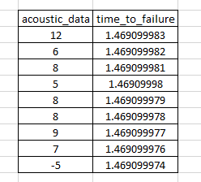
Sample Training Data
Training Set:
The training data is a single sequence of signal and comes from one experiment alone. In total we have 600 million records with two variables the acoustic_data and time_to_failure.
acoustic_data - the seismic signal
time_to_failure - the time (in seconds) until the next laboratory earthquake

Slide 7

Our external collaborator
Swasti Saxena – Geotechnical Engineering Ph.D. student at University of Nevada, Reno
She is currently working on deterministic ground motion simulations using large scale wavefield propagation for her project, ’Toward development of site-specific vertical earthquake ground motion for resiliency of nuclear power plants’.

Slide 8
ETL – Extract Transform Load
After the extraction step, we have around 600 million rows worth of data. Now our primary task is to clean, map and transform the data. We also have to remove the missing values and null values.
We are analyzing the acoustic signals to predict the earthquakes. In each time window of the acoustic signal (also known as strain in terms of earthquake forces), we compute a set potentially relevant statistical features (e.g., mean, variance, kurtosis, and Standard Deviation).
After we have transformed the data, we are going to load this data into our database for analysis

Slide 9
Test Data
The test data consists of several different sequences, called segments, that may correspond to different experiments.
For each test data segment with its corresponding seg_id we will be predicting it's single time until the lab earthquake takes place
seg_id - the test segment ids for which predictions should be made (one prediction per segment)

Slide 10
Causes of Earthquake
To understand the causes of earthquakes we must first explore stress and strain.
The forces that cause deformation are referred to as stresses. In simple words, stress is a force applied over an area.
When a rock is subjected to increasing stress it changes its shape, size or volume. Such a change in shape, size or volume is referred to as a ​strain.​

Slide 11
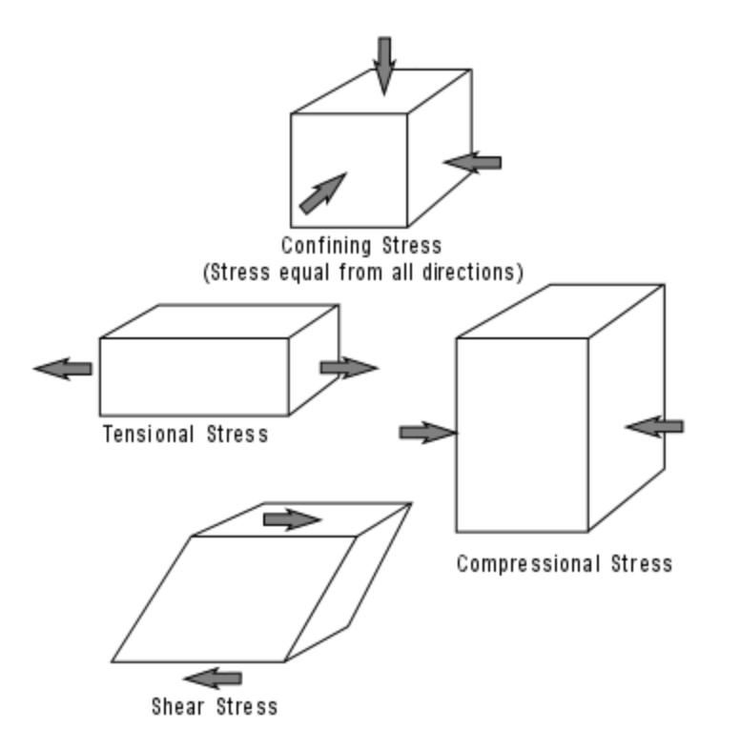

Slide 12


How did we do our analysis ?
We connected our Jupyter notebook to our EC2 instance (AWS) to leverage the power of cloud
We also used tableau for visualization

Slide 13

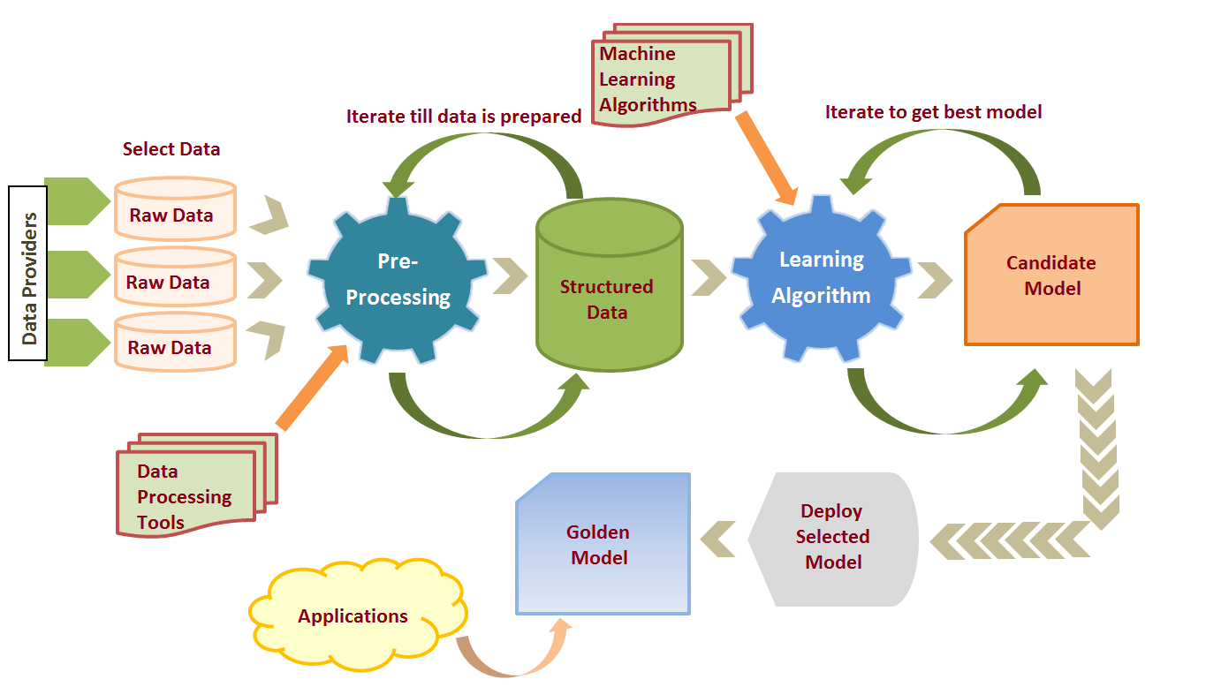
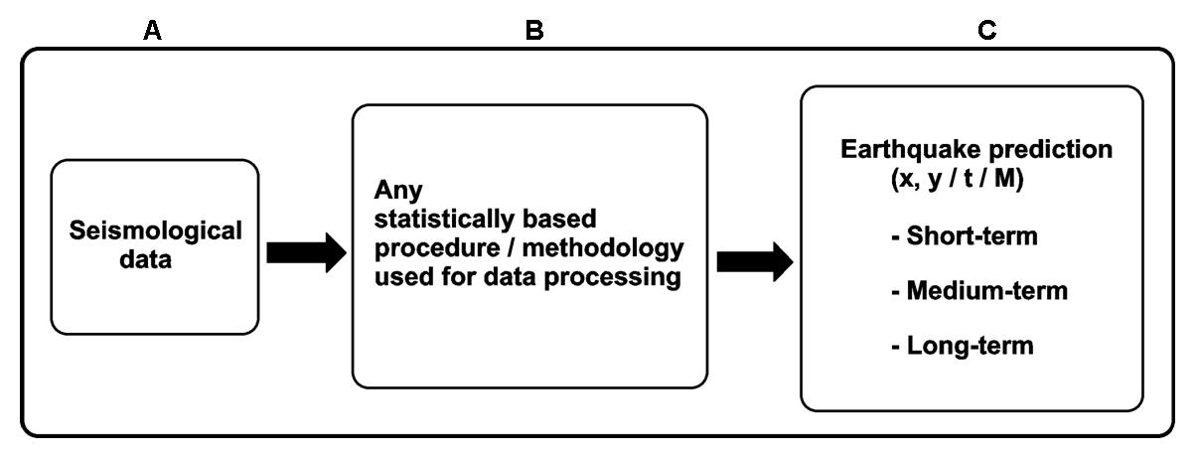


Project Goal

Slide 14
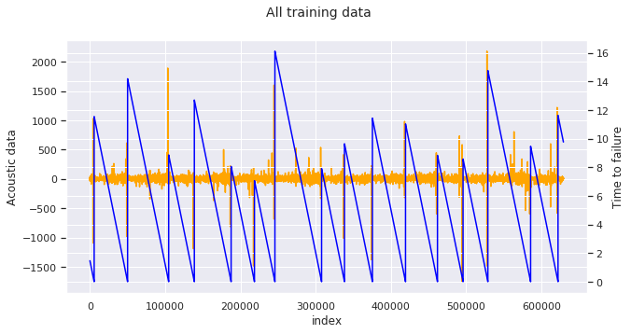
We can see a peak in acoustic data before each earthquake
This is not a perfect rule though: there are some peaks far from earthquakes

Slide 15
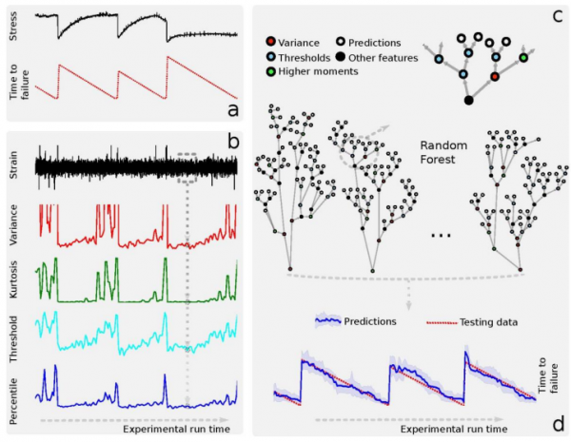
Analyzation Plan
NN-Artificial neural network model
KNN
Linear regression
Radom Forest

Slide 16
Complications
9 GB of Train data – 600 million rows – difficult to load and only 2 features given, one of them is what we have to predict.
Setting up jupyter notebook at ec2 instance and harness the power of AWS to run our code
Understanding basics of earthquake in order to collaborate with the external resource.
Since the data is not exactly seismological data, we had to make notes and explain the external resource our requirements.
Since we were collaborating with an external resource for the contest, benefit – ec2 instance and costs were taken by her, issue – stuck many times for authentication on server because credentials were of others.

Slide 17
Statistical Data created
In addition to the data we collaborated, we used acoustic data to create few more statistical data which greatly impacted the performance of our models :
Variance
Kurtosis
Mean
Median
Percentile
Amax
Amin
STD
Skewness

Slide 18
Prediction Models
Multiple Regression
Used both forward and backward variable selection to find the best accuracy
Random Forest
Ran model with different values of ntree (number of trees to grow) and mtry (Number of variables randomly sampled as candidates at each split) to get maximum accuracy and not over or under fit the model
KNN
Ran model to find best value of K giving minimum error using 10-fold cross validation
Neural Network
Used different values of hidden layers and changing threshold value

Slide 19
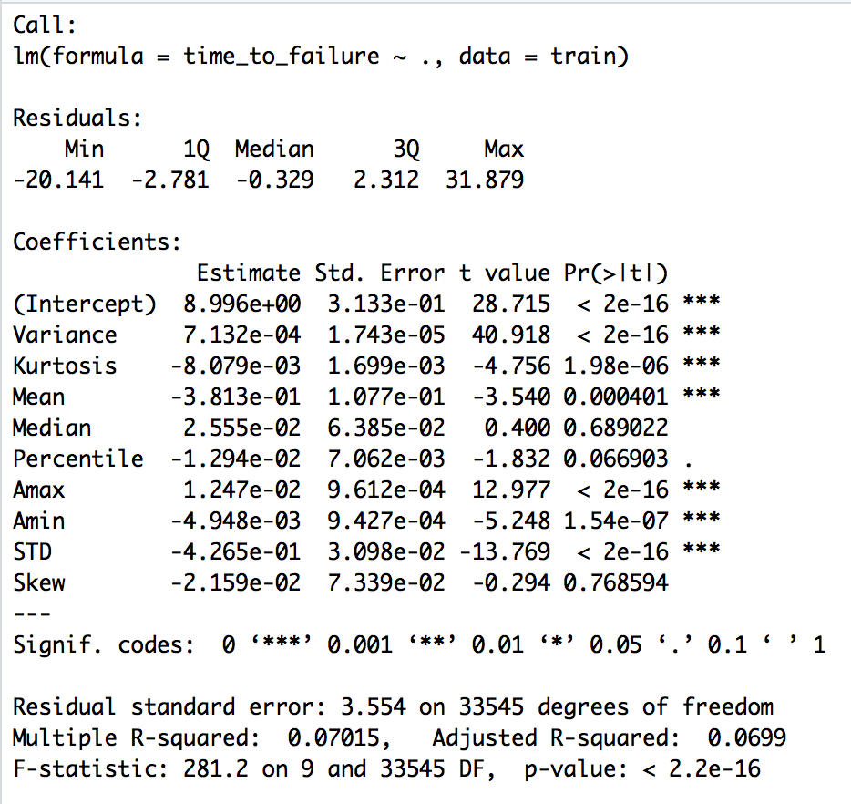
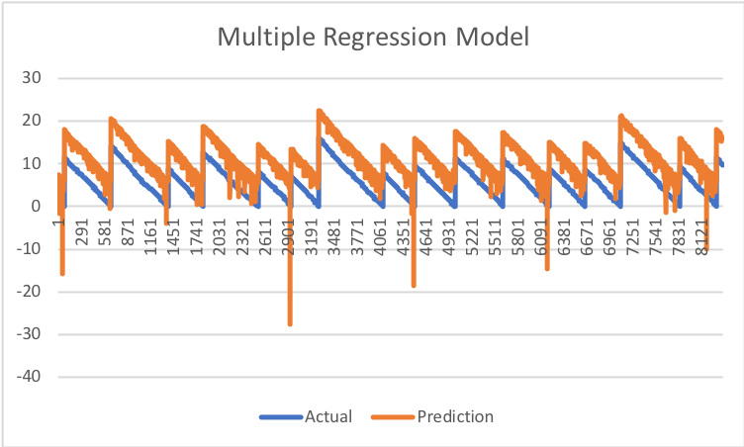
Multiple Regression Output

Slide 20
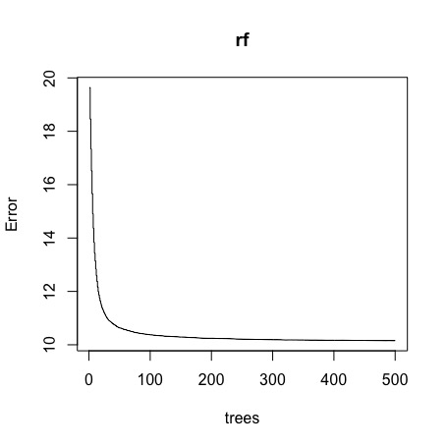
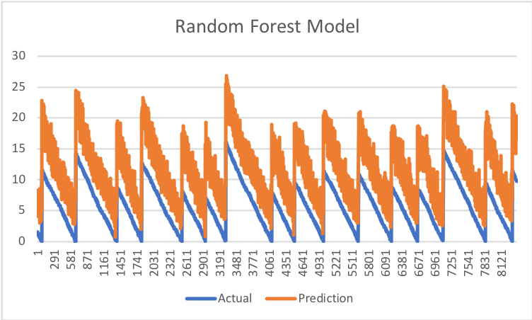
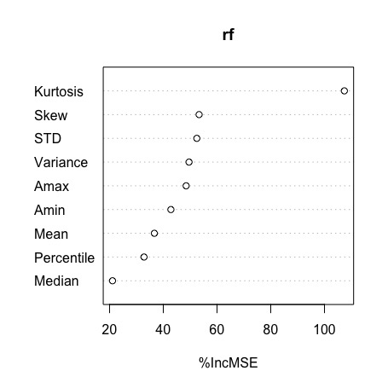
Random Forest Output

Slide 21
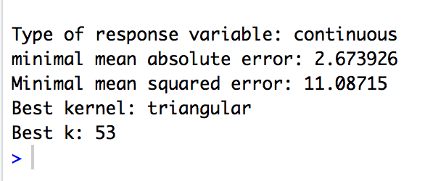
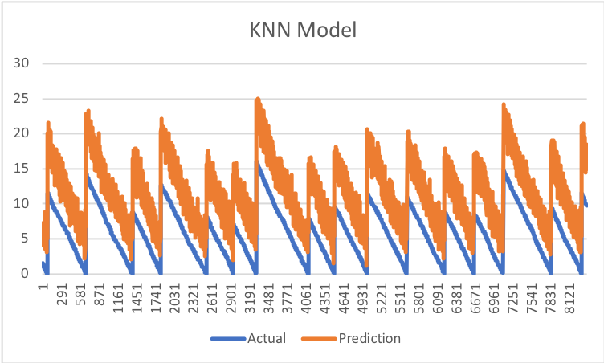
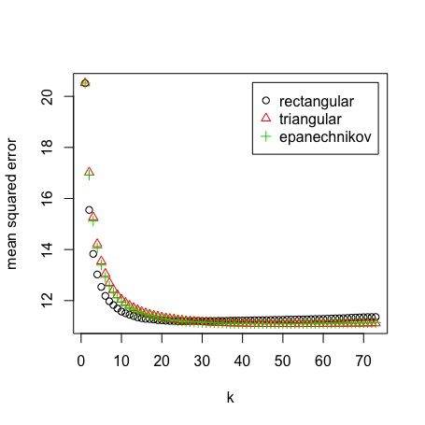
KNN Output

Slide 22
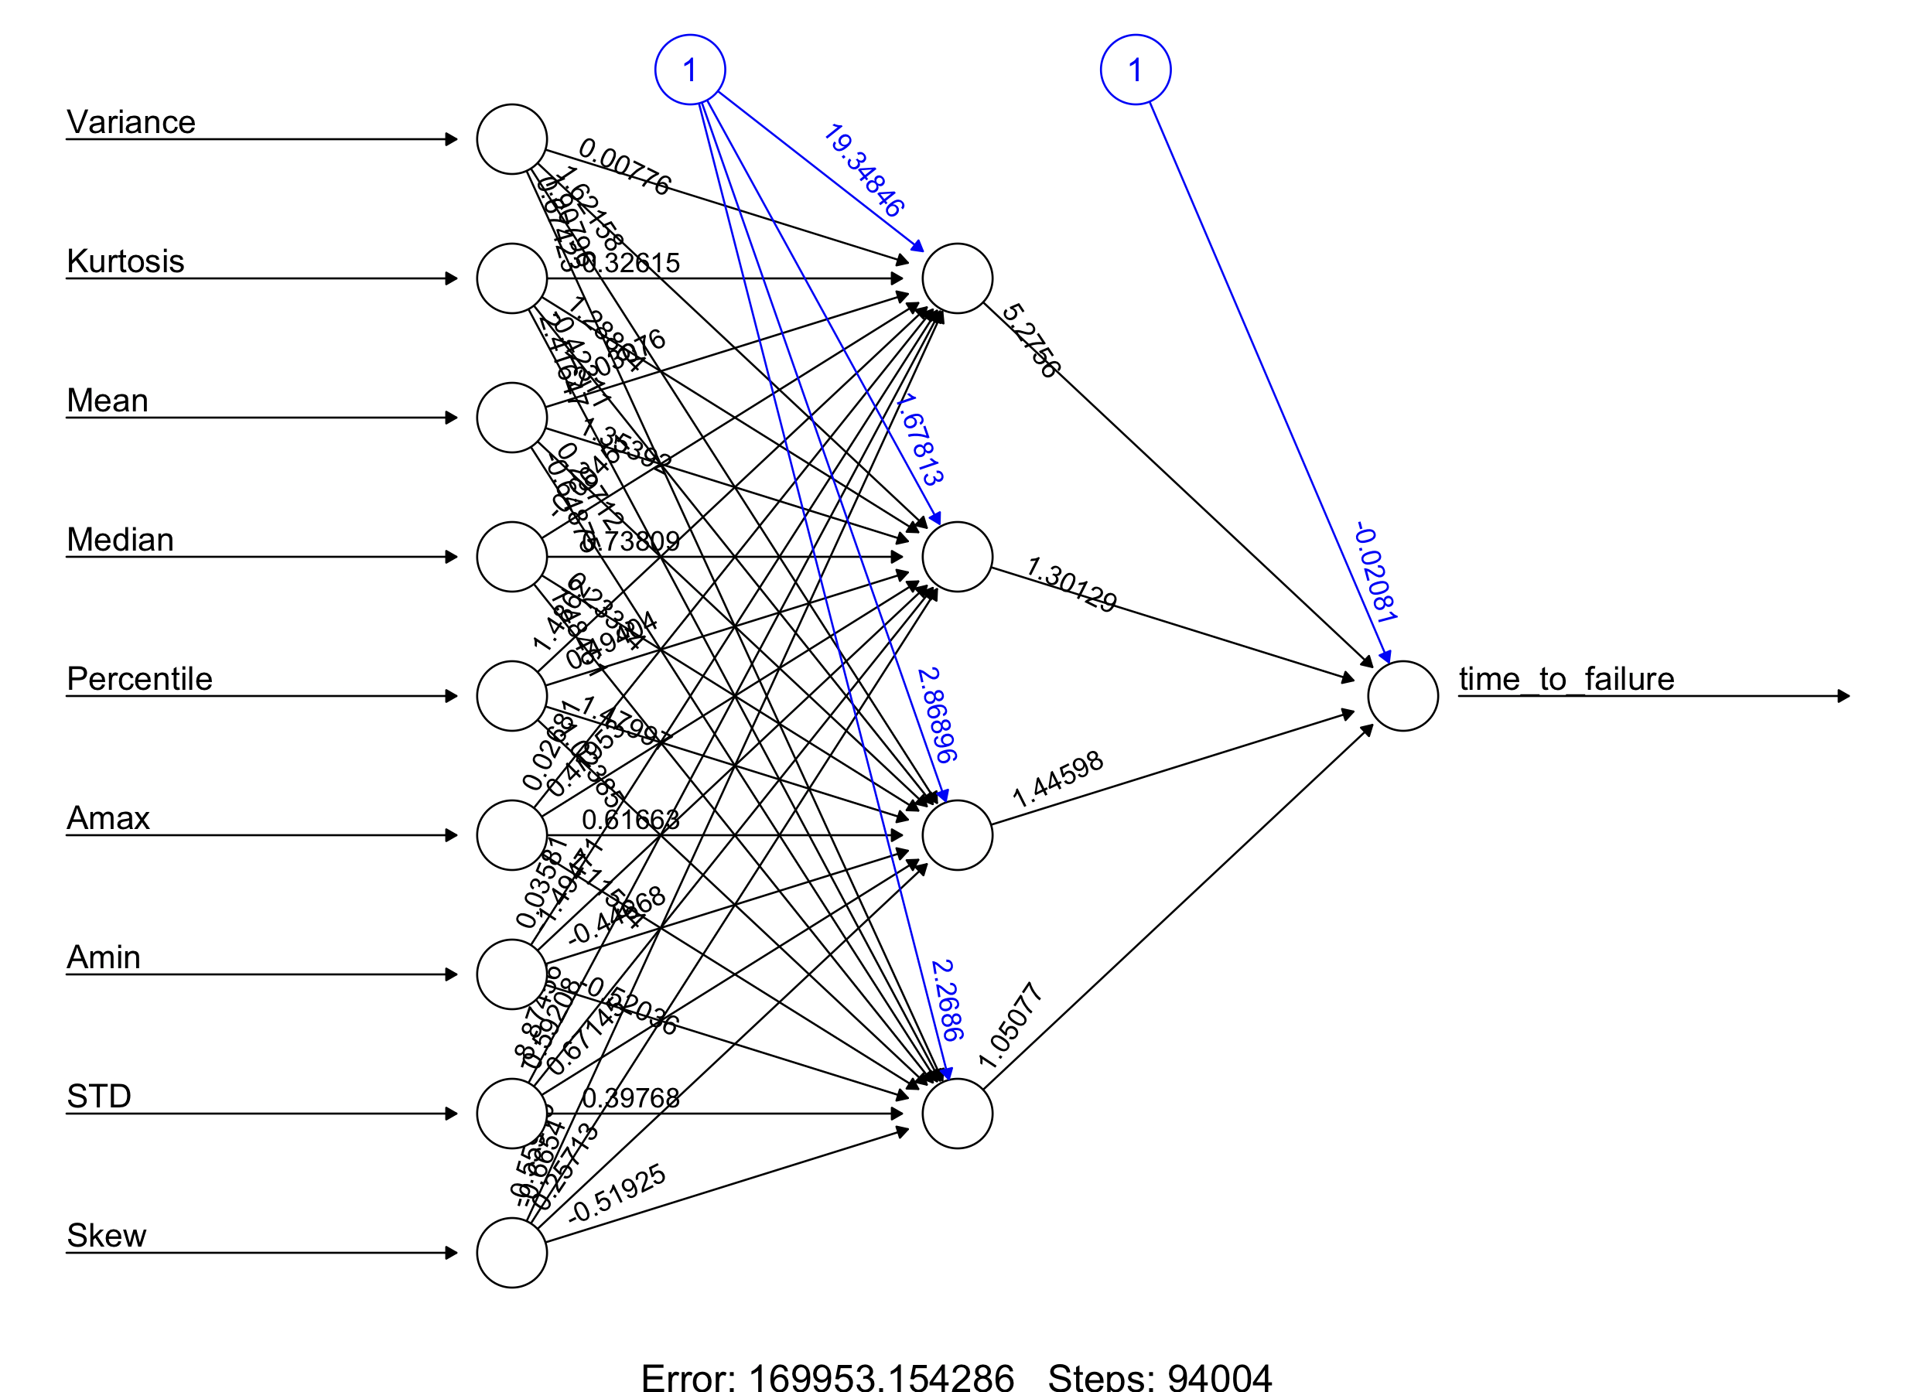
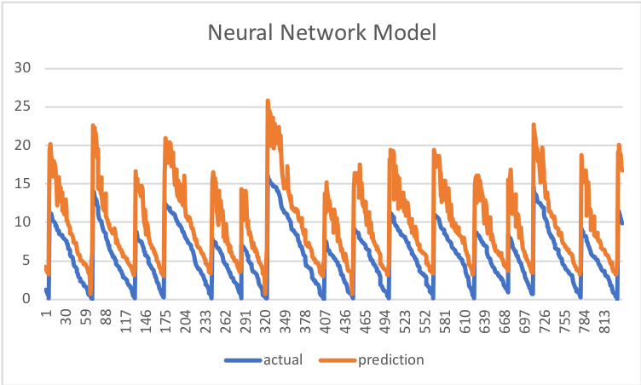
Neural Network Output

Slide 23
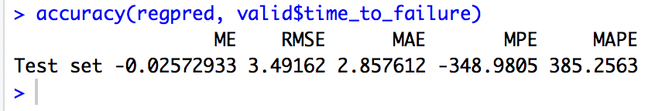
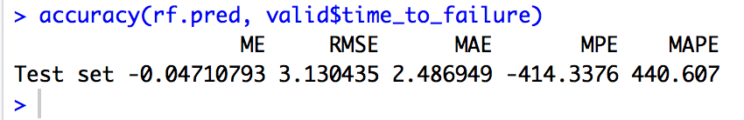
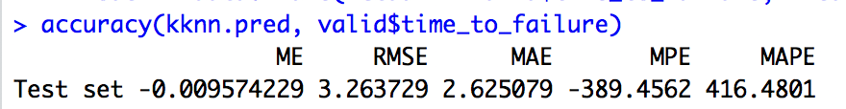
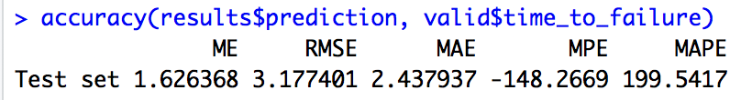
Comparing Errors of all models

Slide 24
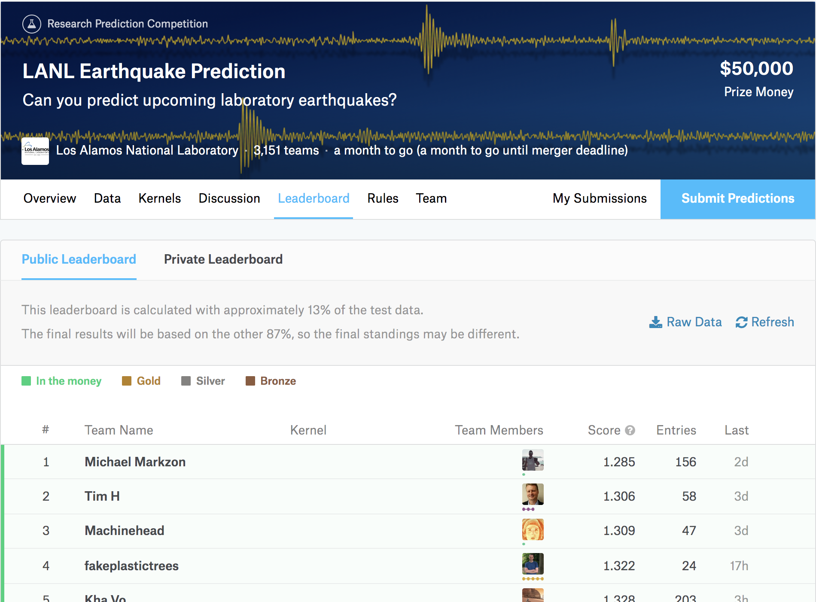
MAE Value required for contest

Slide 25
Future Work
Use the secondary sources of data.
Remove covariance between independent variables.
Increase efficiency of Models by varying their respective attributes.
Choose the best model, run on the Test Data set and submit the final predictions to the contest.

Slide 26
References
arxiv.org/abs/1702.05774: Machine Learning Predicts Laboratory Earthquakes
https://www.technologyreview.com/s/603785/machine-learning-algorithm-predicts-laboratory-earthquakes/
Thi Lu, Ngo & Rodkin, Mikhail & Viet Phuong, Tran & Thi Thu Hang, Phung & Quang, Nguyen & Hoan, Vu. (2016). Algorithm and program for earthquake prediction based on the geological, geophysical, geomorphological and seismic data. VIETNAM JOURNAL OF EARTH SCIENCES. 38. 10.15625/0866-7187/38/3/8708.
Rouet‐Leduc, B., Hulbert, C., Lubbers, N., Barros, K., Humphreys, C. J., & Johnson, P. A. ( 2017). Machine learning predicts laboratory earthquakes. Geophysical Research Letters, 44, 9276– 9282. https://doi.org/10.1002/2017GL074677

Slide 27
References
Earthquakes and EQ Prediction. (2015). Earthquake Prediction with Radio Techniques,1-17. doi:10.1002/9781118770368.ch1
Nanjo, K. Z., Schorlemmer, D., Woessner, J., Wiemer, S., & Giardini, D. (2010). Earthquake detection capability of the Swiss Seismic Network. Geophysical Journal International. doi:10.1111/j.1365-246x.2010.04593.x
Joseph, A. (2011). Earthquake Detection and Monitoring for Early Warnings of Seismogenic Tsunamis. Tsunamis,109-114. doi:10.1016/b978-0-12-385053-9.10007-9
Stefánsson, R. (2011). Application of earthquake prediction to other earthquake-prone regions. Advances in Earthquake Prediction,207-222. doi:10.1007/978-3-540-47571-2_8

Slide 28
Thank You !

